Slide 1
TA Session
2.1.24
Review for PS1
Drawn from slides by Dr. Corcoran & Dr. Osorio

Slide 2
Agenda
Review Topics Covered So Far and Some Key Terms
Inferential Statistics Practice
Questions on PS1
Upcoming Events

Slide 3
Topics Covered So Far
Research Design
Descriptive & Inferential Statistics
Linear Regression

Slide 4
Course Content Questions?

Slide 5
Research Design
Key Terms: Causality & Counterfactual
Examples -
Researchers compared the percent of students who attend college in high schools with college counselors and those without college counselors. They find that schools with college counselors have higher college-going rates.
Can we say that college counselors caused an increase in college attendance? Why or why not?

Slide 6
Research Design
2. Students were randomly assigned to receive tutoring 1-to-1 or in small groups. We found that more students who received tutoring 1-to-1 met grade-level reading standards than those who received tutoring in small groups.
Can we say that 1-to-1 tutoring caused more improvement in reading than small group tutoring? Why or why not?

Slide 7
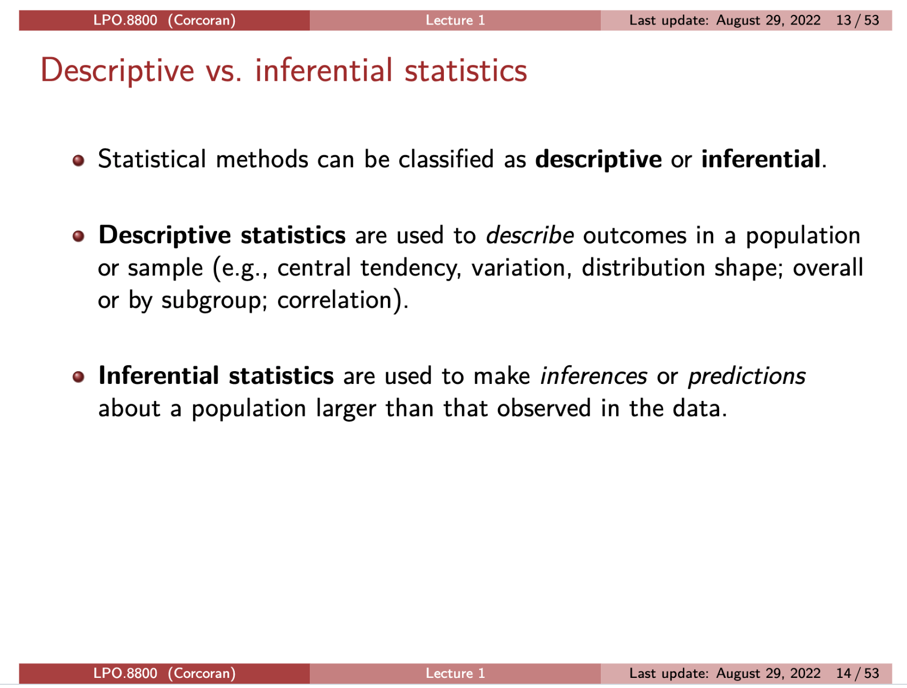

Slide 8
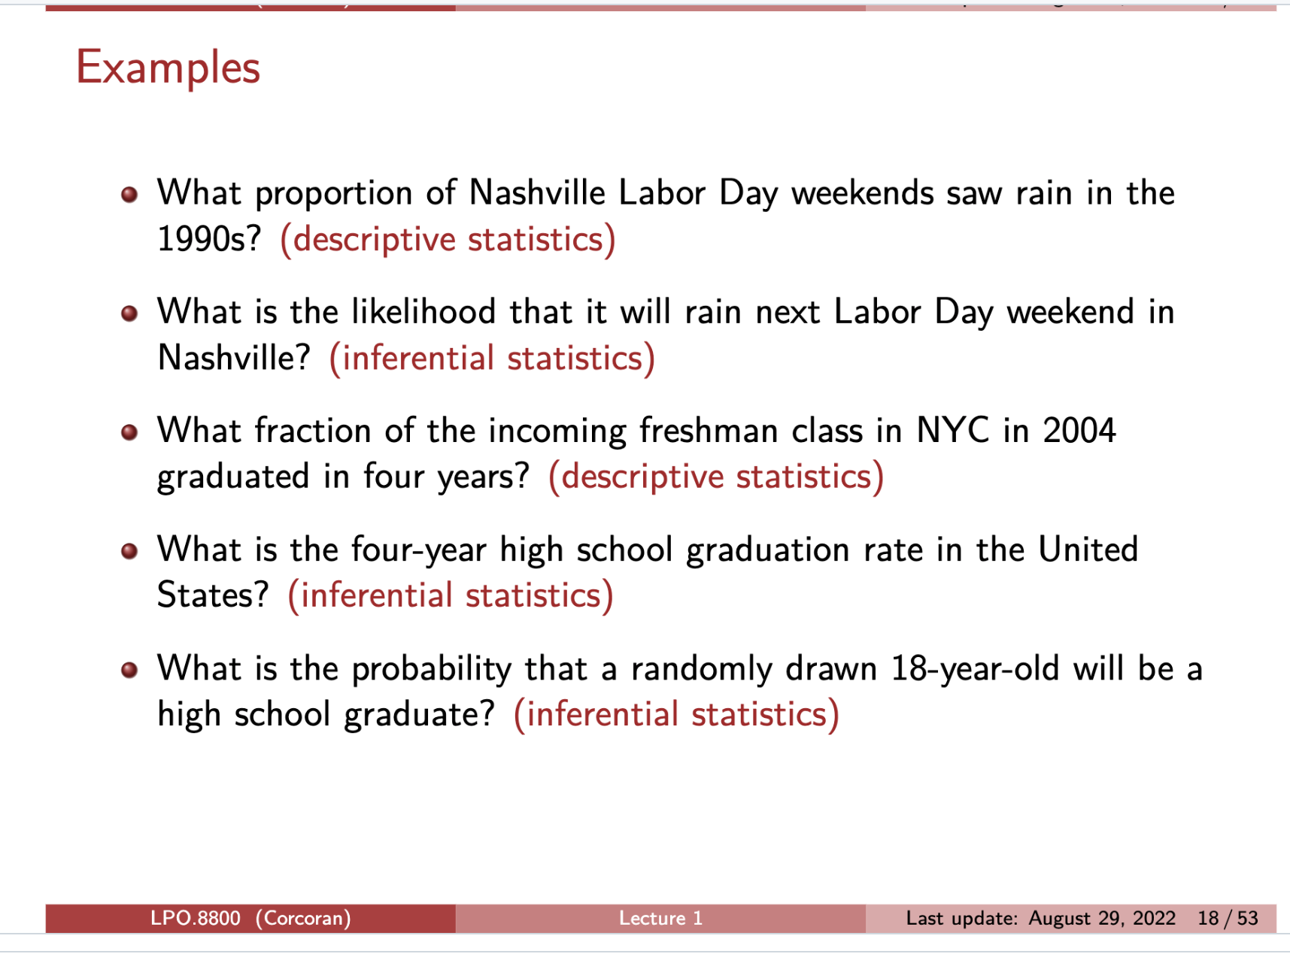

Slide 9
Inferential Statistics
Population -> Parameter
Sample -> Statistic
What does it mean that a statistic (like the sample average) is a random variable?

Slide 10
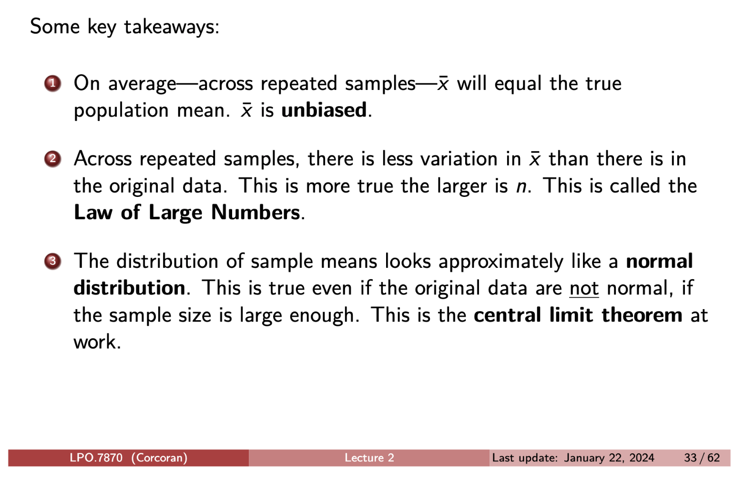
Sampling Distribution of the Mean (Average)

Slide 11
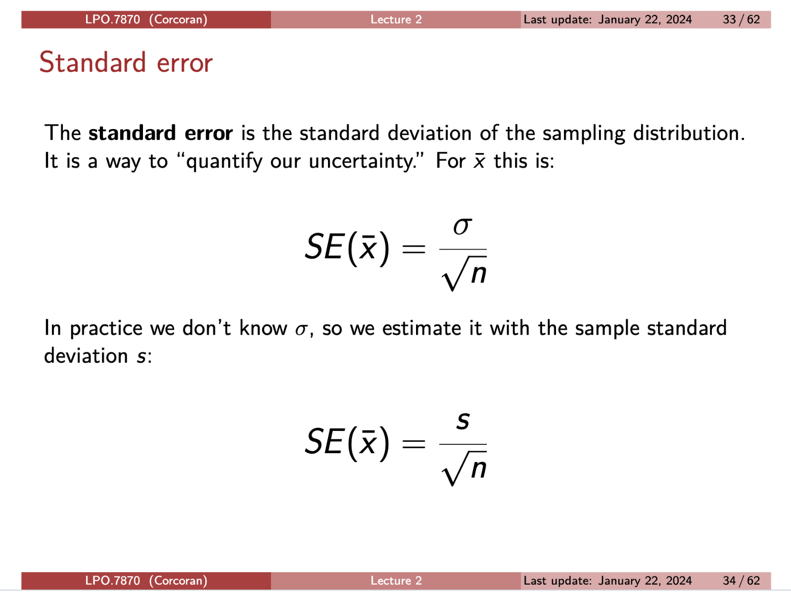

Slide 12
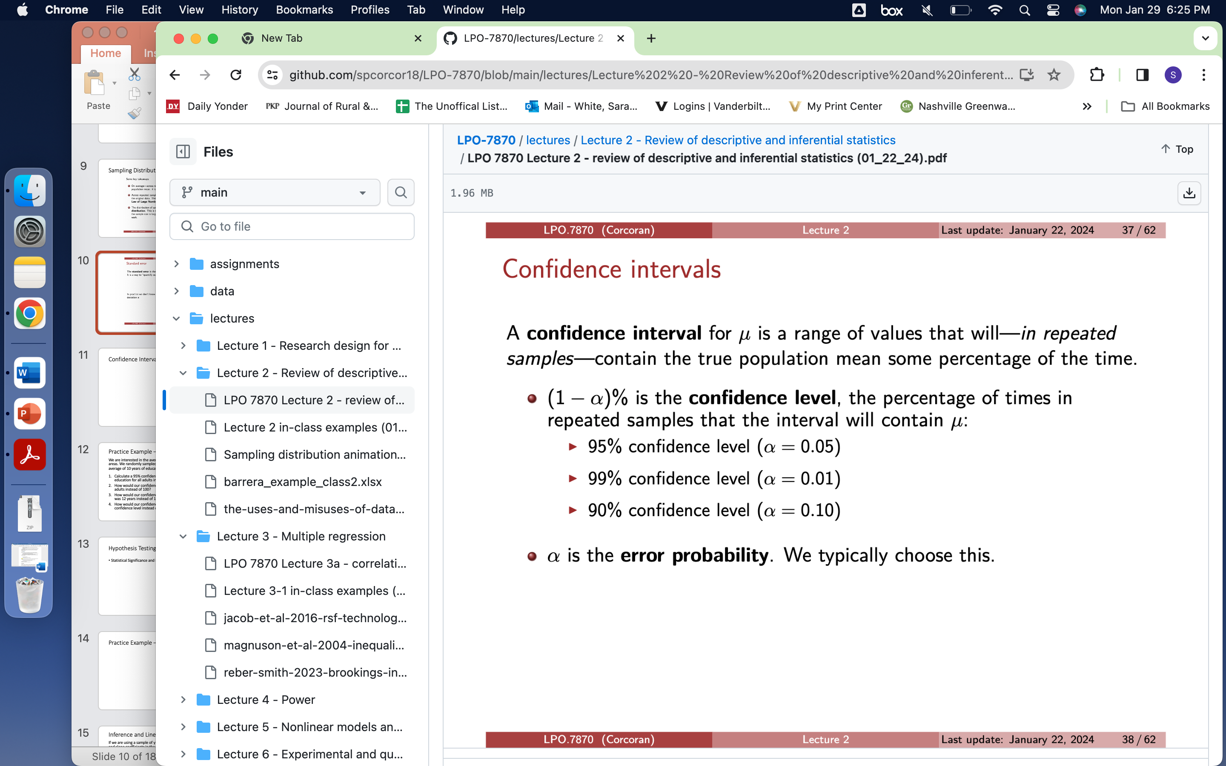
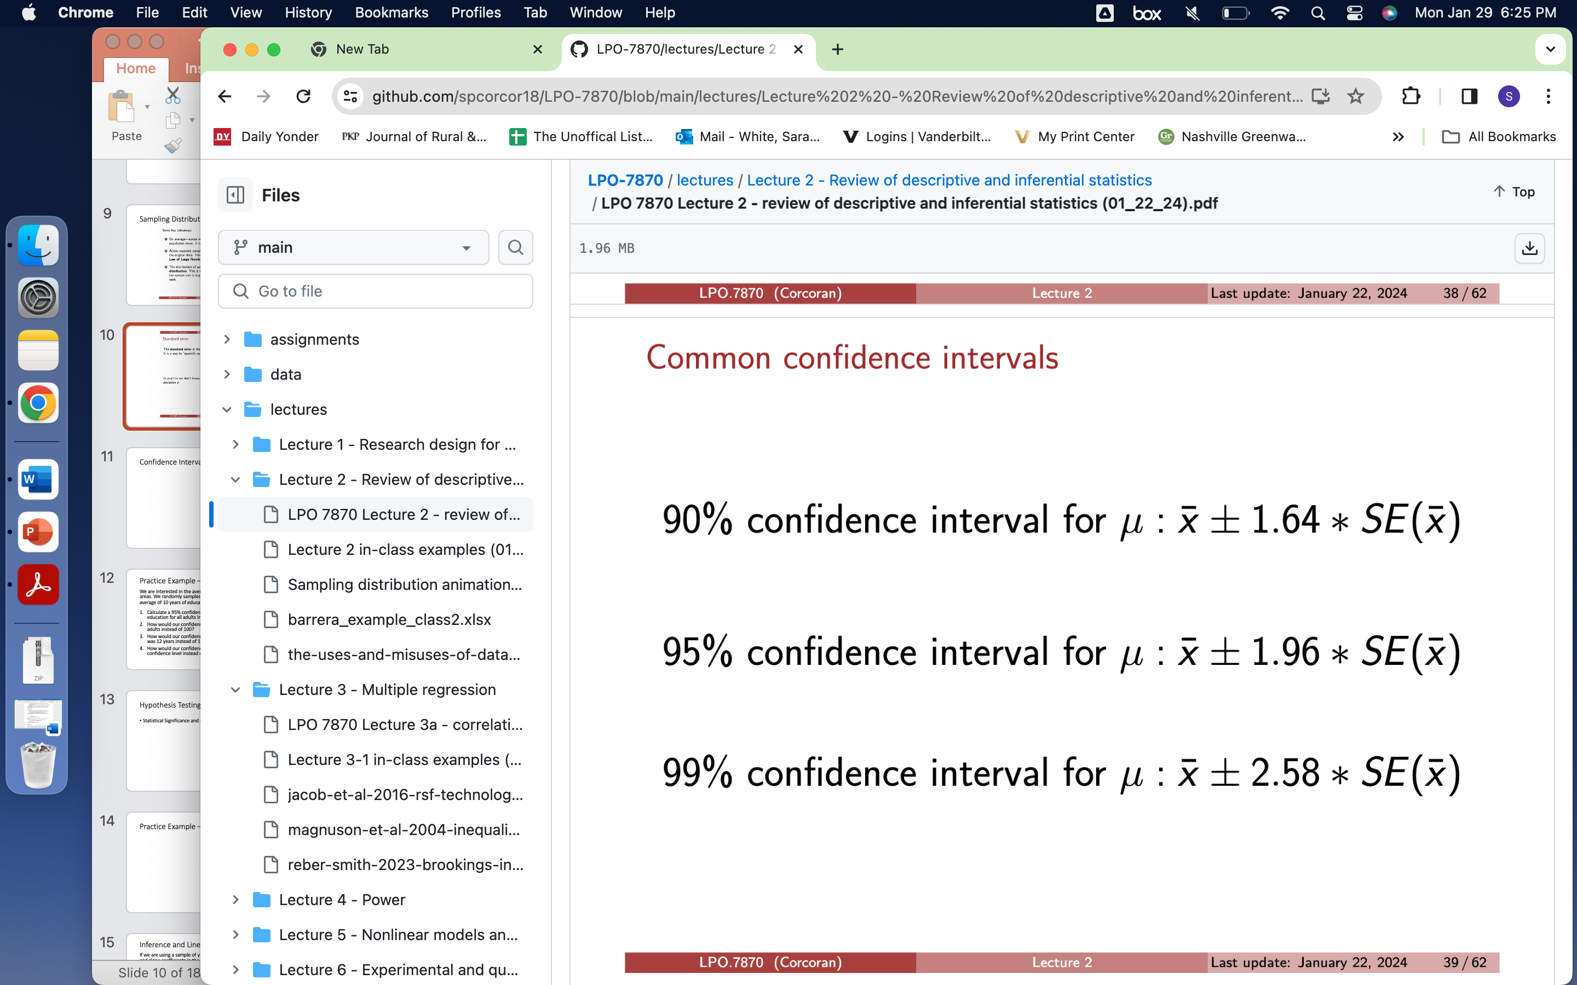

Slide 13
Practice Example – Confidence Intervals
We are interested in the average years of education for adults in urban areas. We randomly sampled 100 adults and calculated a sample average of 10 years of education and a standard deviation of 2.5 years.
Calculate a 95% confidence interval for the average years of education for all adults in urban areas.
How would our confidence interval change if we sampled 200 adults instead of 100?
How would our confidence interval change if the sample average was 12 years instead of 10 years?
How would our confidence interval change if we used a 90% confidence level instead of 95%?

Slide 14
Answer
1. 10 +/- 1.96 * 2.5/sqrt(100) -> 10 +/- 0.25 -> (9.75, 10.25)
2. Narrower, same center
3. Same width, shifted center
4. Narrower, same center

Slide 15
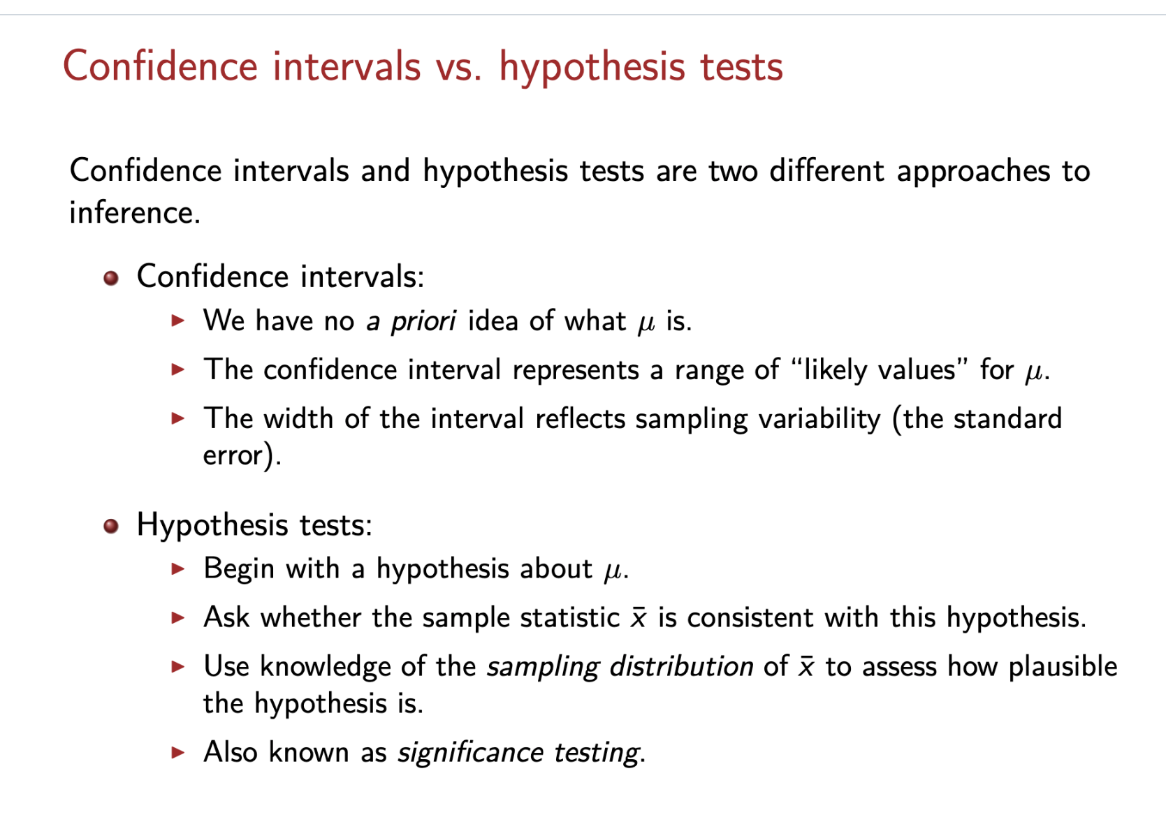

Slide 16
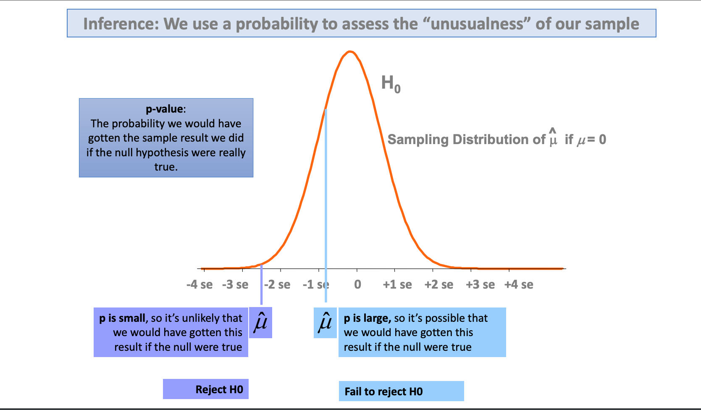

Slide 17
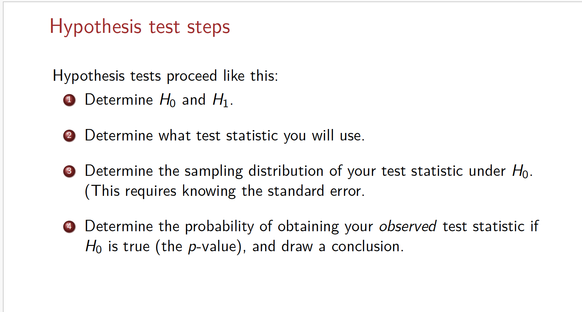

Slide 18
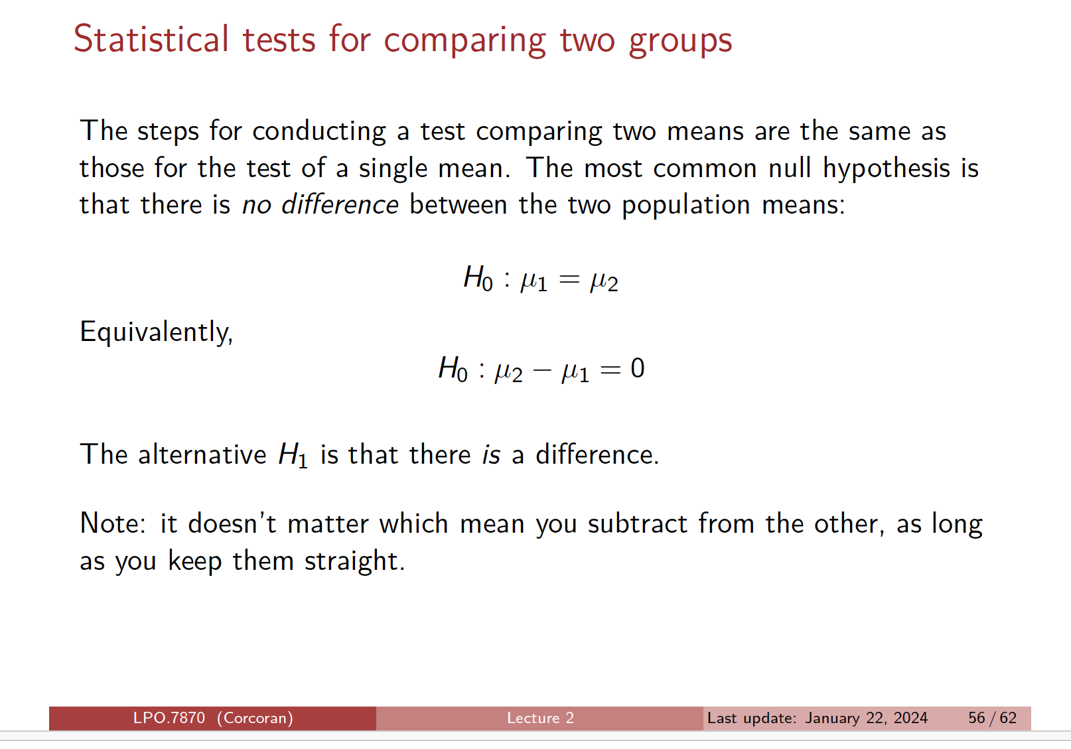

Slide 19
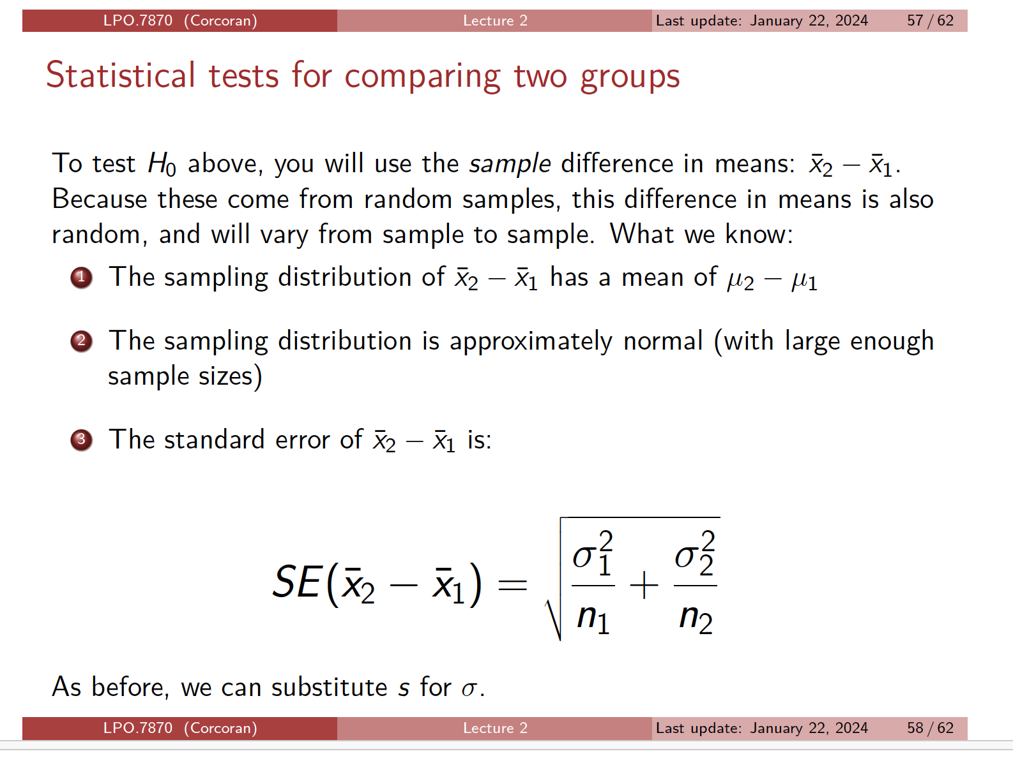

Slide 20
Practice Example – Test for Comparing Two Groups
Remember - We randomly sampled 100 adults in urban areas and calculated a sample average of 10 years of education and a standard deviation of 2.5 years.
Now we random sample 200 adults in rural areas and calculated a sample average of 9.5 years of education and a standard deviation of 2.5 years.
Is there a statistically significant difference between the average years of education adults have in urban areas and rural areas at the 95% confidence level?

Slide 21
Answer
H_o: mean_u = mean_r
H_a: mean_u != mean_r
SE -> sqrt( (2.5^2/100) + (2.5^2/200))
= sqrt(0.0625+0.03125)
= sqrt(0.09375) = 0.306
T_stat = (10 - 9.5)/0.306 = 1.633
1.633 < 1.96
Thus, there is not a statistically significant difference between the average years of education for adults in urban and rural areas. Therefore, we don’t have sufficient evidence to reject the null hypothesis that the average years of education are the same for adults in urban and rural areas.

Slide 22
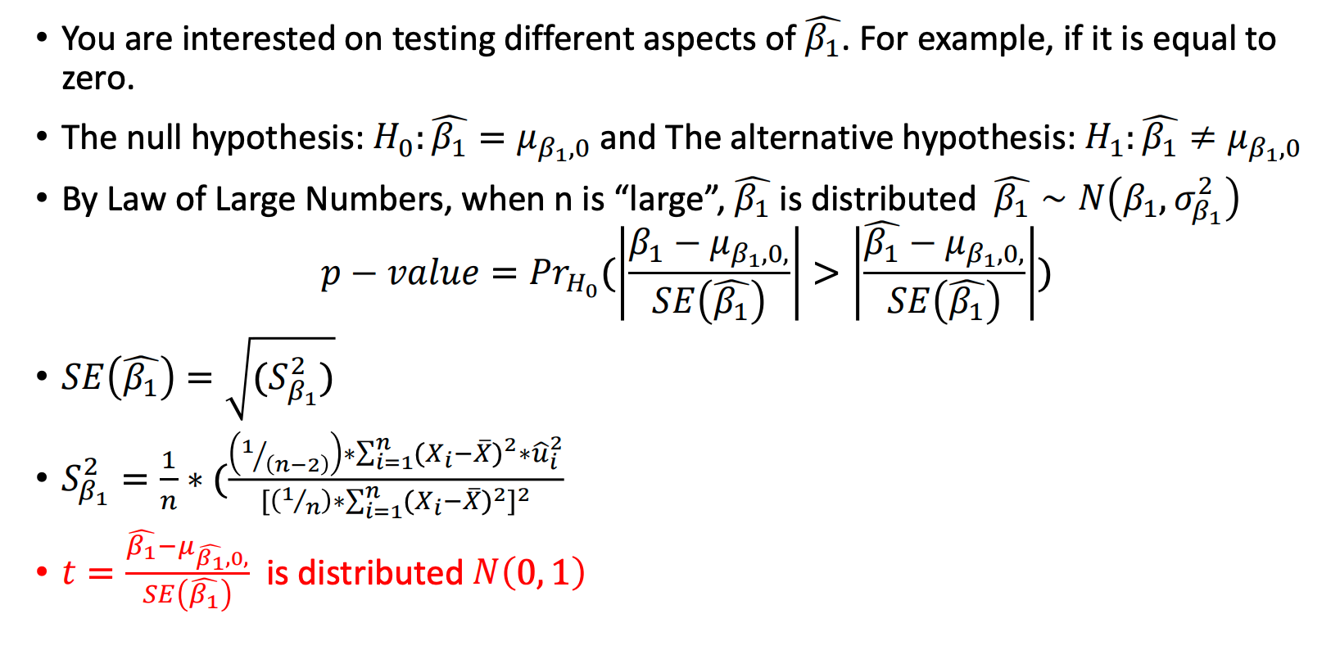
Inference and Linear Regressions
If we are using a sample of y and x to estimate the population intercept and slope coefficients in the population, we need to quantify our uncertainty related to B_0 and B_1 the same way we did for the mean.

Slide 23
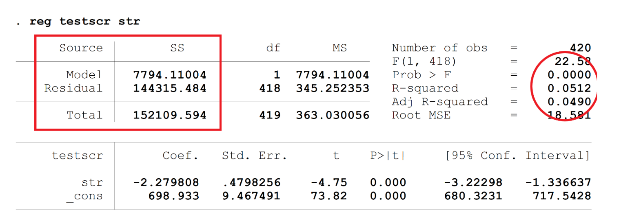

Slide 24
Problem Set Questions?

Slide 25
Upcoming Events
Feb 1 - Help session for PS1 due Feb 5
Feb 15 - Help session for PS2 due Feb 19
(?) Feb 22 - Help session for PS 3 due Mar 4
(?) Feb 29 - Review for Mid-Term on March 4
? Session to Review Mid-Term Answers
Mar 28 - Help session for PS4 due Apr 1
(?) Apr 11 - Help session for PS 4 due Apr 15
(?) Apr 18 - Final Project support

Slide 26
Office Hours
Felipe (email for appt)
Office: Payne Hall 106C
Time: Mondays, 2:00-4:00pm
Kathryn
Office: Payne Hall 011A
Time: Tuesdays, 1:00-3:00pm
Sean (schedule appt)
Office: Payne Hall 205C
Time: Wednesdays, 9:00-11:00am
Sara
Office: Payne Hall 107
Time: Thursdays, 3:00-5:00pm

